Slide 1
Introduction to R Programming and Data Analysis
2018-October-30
LIANG Hai
Assistant Professor
School of Journalism and Communication
hailiang@cuhk.edu.hk
www.DRHAILIANG.COM

Slide 2




Why R?
Programming VS. Data Analysis

Slide 3
Outline
Section I:
Basic Syntax
Data Structure
Programming Tools
Section II:
Data Management
Statistics
Hands-On

Slide 4
Readings
Torfs & Brauer (2014). A (very) short introduction to R.
Kabacoff (2011). R in action: Data analysis and graphics with R.

Slide 5
Section I
Data Structure
Vector
Matrix
Data frame
List
Programing
If-statement
For-loop
Function

Slide 6


1. R + RStudio
Install R
Install RStudio
6

Slide 7
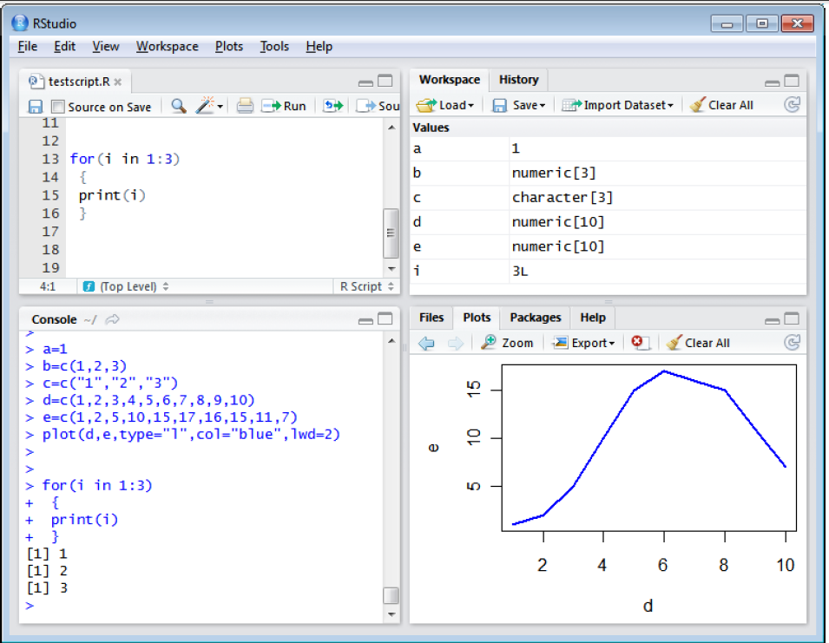
1. R + RStudio
RStudio layout
Working directory
R packages
7

Slide 8
2. Input/output
TXT, CSV
SAV, DTA
Save & load x.Rdata files
read.table(file=“”), read.csv(file=“”); write.table(), write.csv()
library(foreign), read.spss(file=“”, to.data.frame = T), read.dta(file=“”)
save(data,file=“data.Rdata”), load(“data.Rdata”)
8

Slide 9
3. R Basic Syntax
+, -, *, /, ^, sqrt
Variables
Height <- 180, Weight <- 50, print height*weight
Using functions
sum(1,2,3)
mean(1,2,3)

Slide 10
3. R Basic Syntax—Operators
Arithmetic Operators
Logical Operators
Operator | Description | Example
<- | Assign a value | a <- 1+2
+ | Add | x+y
- | Subtract | x-y
* | Multiply | x*y
/ | Divide | x/y
** or ^ | Exponentiation | x^y or x**y
%% | Modulus | x%%y
%/% | Integer division | x%/%y
Operator | Description | Example
<, > | Less, greater than | x<y
<=, >= | Less, greater than or equal to | x>=y
== | Equal to | x==y
!= | Not equal to | x!=y
! | Not | !x
| | Or | x | y
& | And | x & y
isTRUE() | Test if true | isTRUE(x==y)
10

Slide 11
4. Data Types
There are three general modes of data (inside parentheses)
Strings (“Why, hi there”)
Numbers (5)
TRUE/FALSE (TRUE)
Missing data (NA) – Note, there are no quotes (“NA”)

Slide 12
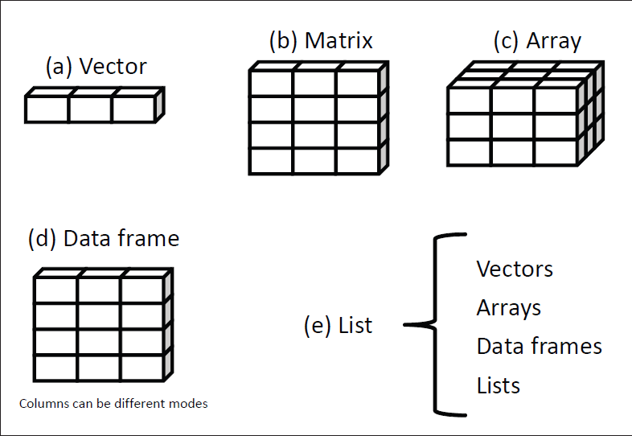
4. Data Structure
Vector
Matrices
Data frames
Lists
Source: Kabacoff (2011)
12

Slide 13
4. Data Structure – Vector
Vector is a list of values [numeric, logic, or string]
Define a vector
V <- c()
V <- c(1,2,”hi”)
V <- seq(5,9,0.5)
V <- c(1:7)
Vector access
V[1], V[1:2], V[c(1,3)]
Vector names
names(V) <- c(“first”, ”second”, ”third”)
V[“first”]
Vector math
V {+,-,*,/} 1
V+V == V*2
V*V == V^2
sqrt(V)
13

Slide 14
4. Data Structure – Matrices
Data in rows and columns (same mode)
Define a matrix
m <- matrix()
matrix(1,5,5)
V <- c(1:9)
m<-matrix(V,3,3)
Matrix access
m[1,2]; m[1,]; m[,2]
m[,2:3]; m[,c(1,3)]
Matrix math
m {+,-,*,/} 1
m+m = m*2
m%*%m
cbind/rbind(m,m)
14

Slide 15
4. Data Structure – Data Frames
Matrix + cols with different modes
Define a data frame
Weights <- c(1:8)
Prices<- c(2:9)
Types <-c(T,F,F,…)
Data <- data.frame(Weights, Prices, Types)
Data frame access
Data[1,2]
Data$Prices, Data[[“Prices”]]
Data frame math
Data$Weigths* Data$Prices
mean(Data$Prices)
merge(data1,data2,by=“Prices”,all=T)
15

Slide 16
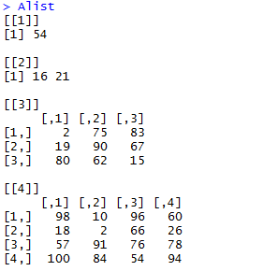
4. Data Structure – Lists
vector + matrix + data frame etc.
Define a list
v1<-c(1,6,7,8)
v2<-c(2,4)
m<-matrix(1,2,4)
L <- list (v1, v2, m)
List access
L[[1]], L[[‘name’]]
16

Slide 17
5. Programming Tools
If-statement
For-loop
Function
if (cond) statement else statement
ifelse (condition, ture, false)
If (cond) {
statement
} else {
statement
}
17

Slide 18
5. Programming Tools
If-statement
For-loop
Function
An example
if (x>50} {
x=100
print (x)
} else if (x<=50 & x>10) {
x=50
print (x)
} else {
print (x)
}
18

Slide 19
5. Programming Tools
If-statement
For-loop
Function
for (name in expr_1) {statements}
while (cond) {statements}
x=c("LH","Jonanthan","winson","Qinjie")
for (name in x) {
print (nchar(name))
}
for (i in 1:4) {
print (nchar(x[i]))
}
19

Slide 20
5. Programming Tools
If-statement
For-loop
Function
myfuction <- function(arg1=default,arg2,…) {
statements
return (objects)
}
space <- function(len=5,wid=20){
sp<-len*wid
return (sp)
}
20

Slide 21
Hands-On
Homework 1
Create a list with length 10: for the first component list[[1]], the dimension is 1, the second is 1*2, the third is 3*3, the fourth is 4*4, and so on. The values should be selected randomly from 1:100.
For each component in the list, select the values > 50
and write a function to calculate a value = sd (values)/mean(values) when length(values)>1, otherwise return 0.
Loop for each component, you will get 10 values, and then calculate the sum of the 10 values
Repeat the process for many times (could you find any patterns?)

Slide 22
Section II
Data Management
Aggregating
Reshaping
Statistics
Descriptive
Graphics
Linear Model

Slide 23
6. Data Management
Basics
Crating new variables
Recoding variables
Renaming variables
Missing value
Merging datasets
Subsetting datasets
Advances
Aggregating dataset
The reshape package
install.packages(“reshape”)
library(reshape)
cast()
melt()

Slide 24
6. Data Management – Basics I
Creating new variable
load("sample.Rdata") # set working directory
tst3$wc = as.numeric(tst3$word_count)
Recoding a variable
tst3 = within(tst3,{
long <- NA # initiate a new variable
long[wc>500] <- "Yes"
long[wc <= 500] <- "No" })

Slide 25
6. Data Management – Basics II
Renaming variable
colnames(tst3)[8] = "long_article“
Missing value
tst3$wc[501] = NA
is.na(tst3$wc)
tst3$wc[is.na(tst3$wc)]=0
tst3$wc[501]
sum(c(1,2,3,NA))
sum(c(1,2,3,NA),na.rm=T)

Slide 26
6. Data Management – Basics III
Subsetting datasets
Selecting/keeping variables
newd_1 = tst3[,c(1,3)]
newd_2 = tst3[,c("id","pub_date")]
Dropping variables
newd_3 = tst3[,c(-2,-3)]
newd_4 = tst3[!(names(tst3)%in%c("section_name","pub_date"))]
newd_4$id = NULL
Selecting observations
newd_5 = tst3[which(tst3$long=="Yes"),]

Slide 27
6. Data Management – Advances I
Aggregating
aggregate(data,by,FUN)
agg_1 = aggregate(tst3$wc,by=list(tst3$section),FUN="mean")
aggregate(y~x,data,FUN)
agg_2 = aggregate(wc~section,tst3,FUN="mean")
aggregate(cbind(y1+y2)~x,data,FUN)
tst3$n=1
agg_3 = aggregate(cbind(wc,n)~section,tst3,FUN="sum")

Slide 28
6. Data Management – Basics IV
Merging datasets
Adding columns
colnames(agg_1)[2] = "avg"
tst3 = merge(tst3,agg_1,by="section")
Adding rows
total <- rbind(dataframeA,dataframeB)

Slide 29
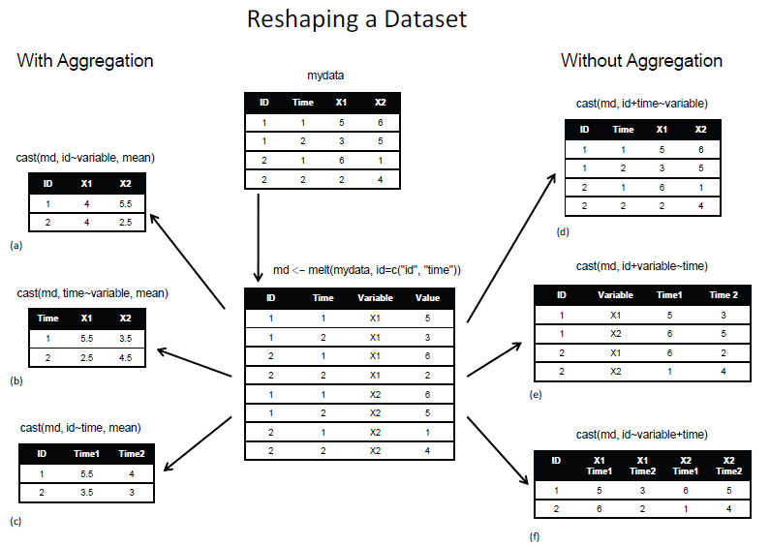
6. Data Management – Advances II
Reshaping data with the melt() and cast() functions in Kabacoff (2011), p115.

Slide 30
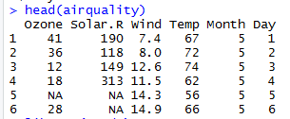
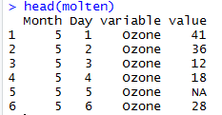
6. Data Management – Advances II
library(reshape)
library(datasets)
head(airquality)
# vars to cases:
molten = melt(airquality,id=c("Month","Day"))
# cases to vars:
data = cast(molten,Month+Day~variable)

Slide 31
7. R for Statistics
Descriptive
Descriptive
Chi-square test
T-test
Correlation
One way ANOVA
Graphs
Bar plot
Histogram
Scatter plot
Linear Model
Estimation
Diagnosis
information
31

Slide 32
7. R for Statistics – Descriptive I
Descriptive statistics
via summary()
summary(tst3)
via by()
by(tst3[,c("wc","avg")],tst3$long,summary)
via table()
table(tst3$section,tst3$long)
32

Slide 33
7. R for Statistics – Descriptive II
Descriptive statistics
Chi-square test [significance indicates ‘Not Independent’]
install.packages("vcd")
library(vcd)
mytable<-xtabs(~section+long, data=tst3)
chisq.test(mytable)
Categories association
assocstats(mytable)
Correlation
cor(tst3$wc,tst3$avg,method="spearman",use="complete.obs")
cor.test(tst3$wc,tst3$avg, alternative = "two.side", method ="pearson" )
33

Slide 34
7. R for Statistics – Descriptive III
Descriptive statistics
T-test
t.test(wc~long,tst3)
One-way ANOVA
fit<-aov(wc~long,data=tst3)
summary(fit)
TukeyHSD(fit)
34

Slide 35
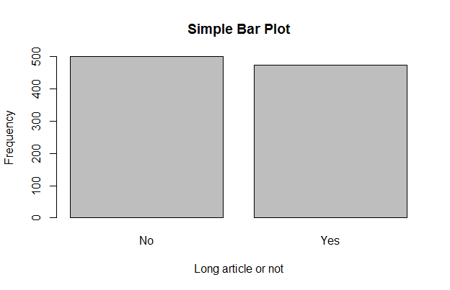
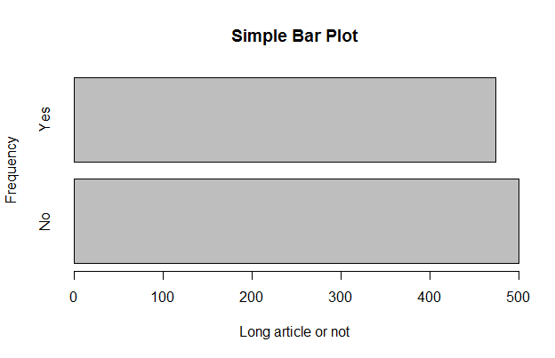
7. R for Statistics – Graphs I
count<-table(tst3$long)
barplot(count,main="Simple Bar Plot",
xlab="Long article or not", ylab="Frequency")
barplot(count,main="Simple Bar Plot",
xlab="Long article or not", ylab="Frequency", horiz=TRUE)
35

Slide 36
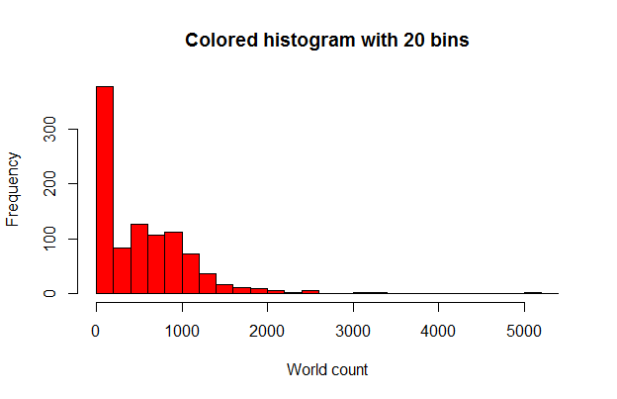
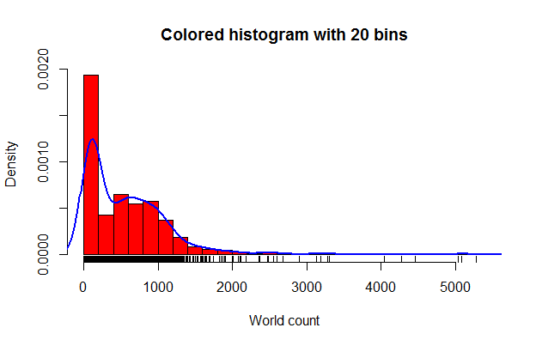
7. R for Statistics – Graphs II
hist(tst3$wc,breaks=20,
col="red",
xlab="World count",
main="Colored histogram with 20 bins")
hist(tst3$wc,breaks=20,
freq = F,
col="red",
xlab="World count",
main="Colored histogram with 20 bins")
rug(jitter(tst3$wc))
lines(density(tst3$wc), col="blue", lwd=2)
36

Slide 37
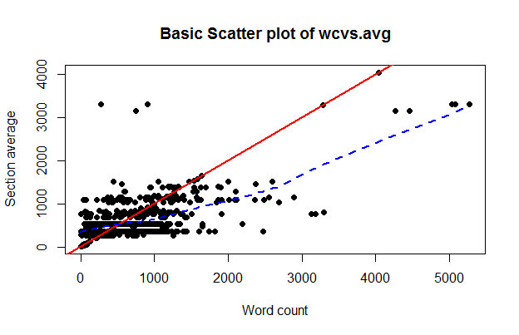
7. R for Statistics – Graphs III
plot(tst3$wc,tst3$avg,
main="Basic Scatter plot of wc vs.avg", xlab="Word count",
ylab="Section average", pch=19)
abline(lm(tst3$wc~tst3$avg), col="red", lwd=2, lty=1)
lines(lowess(tst3$wc,tst3$avg), col="blue", lwd=2, lty=2)
?!
37

Slide 38
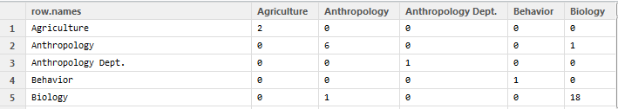
Hands-On
Homework 2
Read the csv file “authorlist.csv”
Select columns “Author Name” and “Discipline”. The variable discipline contains one or a set of words.
Output: a co-occurrence matrix M, e.g., M[1,1] =
communication, health, 5 authors
38

Slide 39
Q & A

